Slide 1
ANOVA and T-test
Gopika Dinesh K C
AM.PS.R4MAT24001
Course Title: Research Methodology in Applied Sciences
30 October 2024

Slide 2
Contents
Introduction
ANOVA
T-test

Slide 3
Introduction
Sample: A subset or small portion of data that is used to make inference about the whole data.
Hypothesis Testing: A statistical hypothesis is usually a statement about a set of parameters of a population distribution. The objective of a statistical test is not to explicitly determine whether or not H0 (Null Hypothesis) is true but rather to determine if its validity is consistent with the resultant data.

Slide 4

F-Test
F test uses f test statistic to check whether the variances of two samples (or populations) are equal.
Left Tailed Test:
Null Hypothesis: H0 : ${\text{σ}\text{1}}^{2}$= ${\text{σ}\text{2} }^{2}$
Alternate Hypothesis: H1 : ${\text{σ}\text{1}}^{2}<$ ${\text{σ}\text{2} }^{2}$
If the f statistic < f critical value then reject the null hypothesis

Slide 5

Right Tailed test:
Null Hypothesis: H0 : ${\text{σ}\text{1}}^{2}$= ${\text{σ}\text{2} }^{2}$
Alternate Hypothesis: H1 : ${\text{σ}\text{1}}^{2}>$ ${\text{σ}\text{2} }^{2}$
If the f statistic < f critical value then reject the null hypothesis
Two Tailed test:
Null Hypothesis: H0 : ${\text{σ}\text{1}}^{2}$= ${\text{σ}\text{2} }^{2}$
Alternate Hypothesis: H1 : ${\text{σ}\text{1}}^{2}$≠${\text{σ}\text{2} }^{2}$
If the f statistic < f critical value then reject the null hypothesis

Slide 6
ANOVA
Analysis of Variance (ANOVA).
Use when we need to find the significant difference between two or means at the same time.
To check if an independent variable have an effect on the dependent variable.
Example: To check the effect of different types of fertilizers in the growth of plant.

Slide 7
Null Hypothesis (H0):
All means are equal,
H0: µ0=µ1=µ2= …..=µn
Alternate Hypothesis(H1):
Not all means are equal.

Slide 8

Variance
$S^{2}=\frac{\sum_{i=1}^{n}{{(X−\overline{X})}^{2}}}{n−1}$
X is the datapoint
$\overline{X}$is the mean
n is the sample size

Slide 9
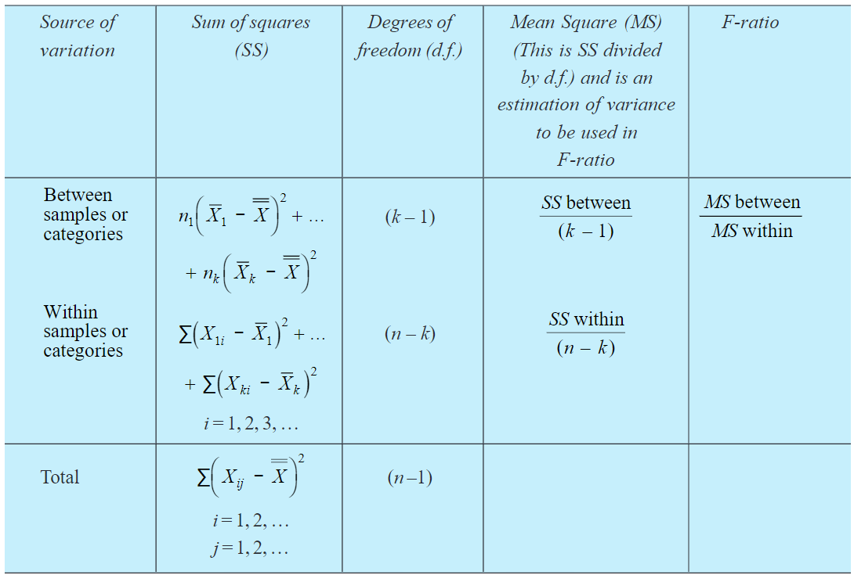
Types of ANOVA
One Way ANOVA

Slide 10
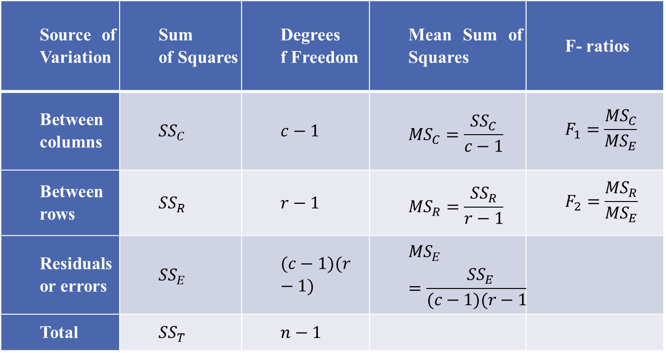
Two Way ANOVA
o

Slide 11
Steps
Calculate the mean square error between groups and within groups.
Find the F value
Find Fɑ(db,dw), where ɑ is the significance level db and dw are degrees of freedom.
If F > Fɑ(db,dw)
Reject H0

Slide 12
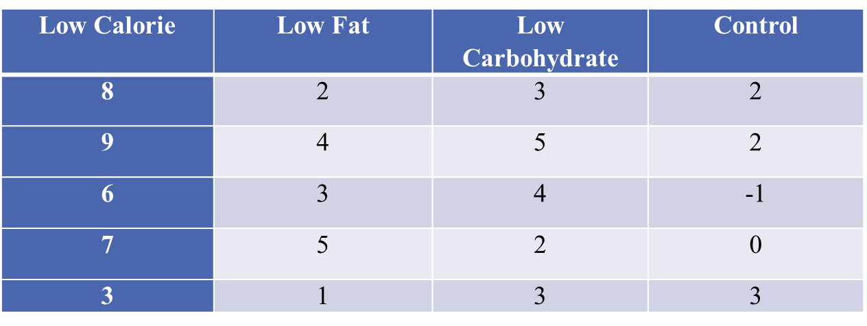
Example
Four popular weight loss programs are considered. The first is a low-calorie diet, the second is a low-fat diet, the third is a low- carbohydrate diet and the fourth is a control diet. A total of twenty patients participate in a study of healthy behaviours with weight loss and the patients were randomly assigned to one of the four diet groups. The difference in weights after and before participation is given below
Positive differences indicate weight loss and negative differences indicate weight gain. Is there a statistically significant difference in the mean weight loss among the four diets?

Slide 13
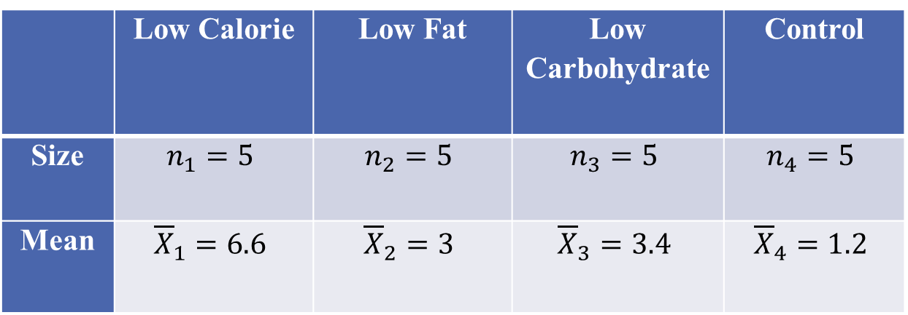

Solution
Let $μ_{1}$, $μ_{2}, μ_{3}$ and $μ_{4}$ be mean weight loss for each program
$H_{0}:μ_{1}{=μ}_{2}= μ_{3}=μ_{4}$ against $H_{1}:$at least two means are not equal
$k=4$
$n=n_{1}+n_{2}+ n_{3}+ n_{4}$

Slide 14
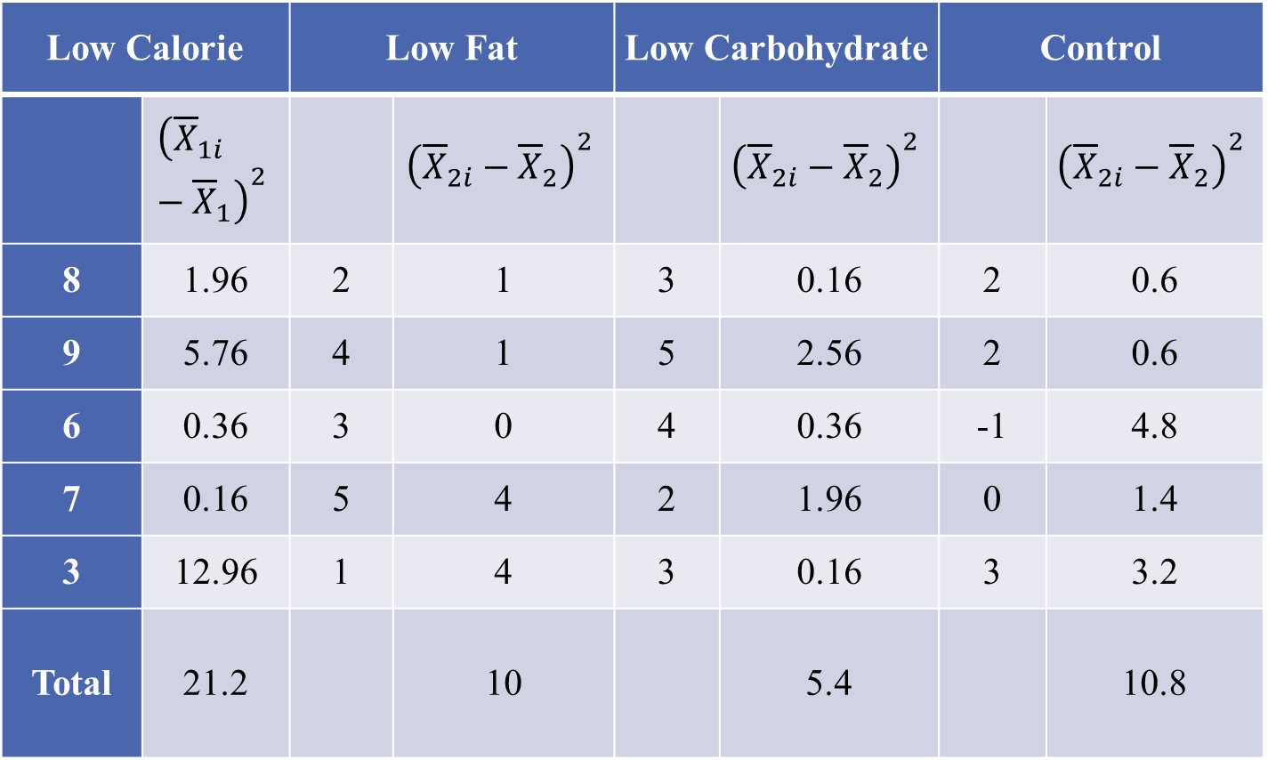

Mean of the sample Means
$\overline{\overline{X}}=\frac{{\overline{X}}_{1}+{\overline{X}}_{2}+{\overline{X}}_{3}+{\overline{X}}_{4}}{4}=3.6$
$${SS}_{B}=n_{1}{\left({\overline{X}}_{1}−\overline{\overline{X}}\right)}^{2}+n_{2}{\left({\overline{X}}_{2}−\overline{\overline{X}}\right)}^{2}+n_{3}{\left({\overline{X}}_{3}−\overline{\overline{X}}\right)}^{2}+n_{4}{\left({\overline{X}}_{4}−\overline{\overline{X}}\right)}^{2}=75.8$$
$${SS}_{w}=\sum{{\left({\overline{X}}_{1i}−{\overline{X}}_{1}\right)}^{2}}+\sum{{\left({\overline{X}}_{2i}−{\overline{X}}_{2}\right)}^{2}+\sum{{\left({\overline{X}}_{3i}−{\overline{X}}_{3}\right)}^{2}}+\sum{{\left({\overline{X}}_{4i}−{\overline{X}}_{4}\right)}^{2}}}$$
$=21.2+10+5.2+10.6=47$
${SS}_{T}={SS}_{B}+{SS}_{w}$

Slide 15
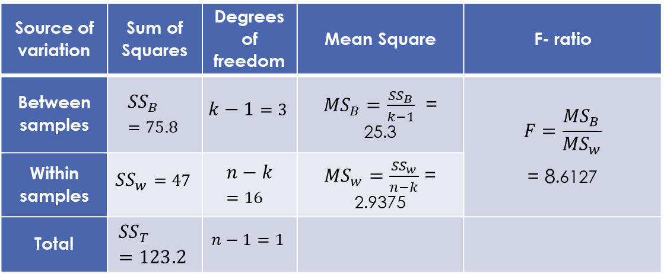

At a 5% significance level,
Table value $F_{0.05}\left(3, 16\right)=3.23$
Here $F$> $F_{0.05}(3, 16)$, reject $H_{0}$
i. e, there is a significant difference in the mean weight loss among the four diets

Slide 16
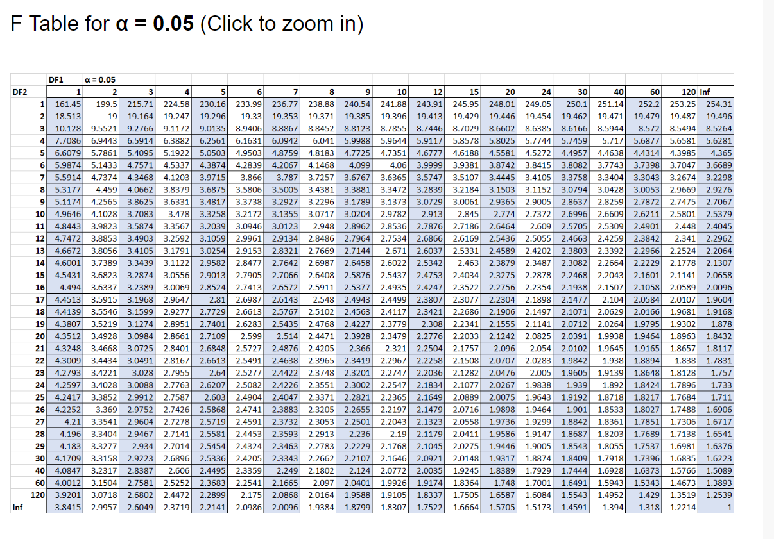

Slide 17
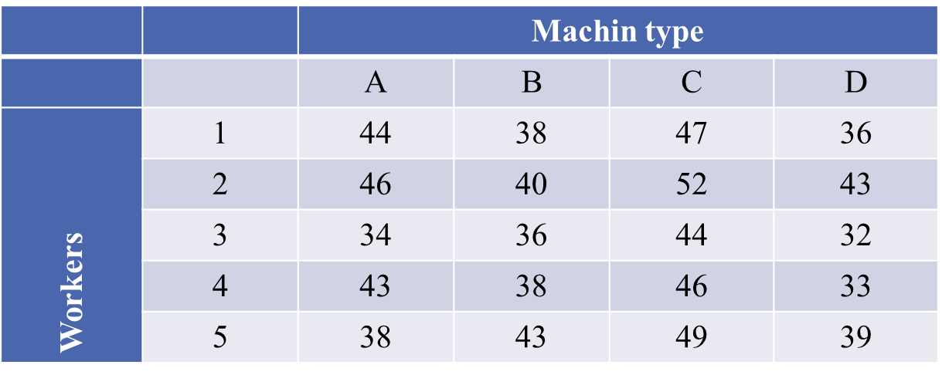
Example
The following data represent the number of units of production per day turned out by 5 different workers using different types of machines
Test whether the mean productivity is the same for the different machine types and for workers respectively

Slide 18

Let $μ_{1}$,$μ_{2}, μ_{3}$ and µ4 be mean productivity of the 4 machines respectively and Let $β_{1}$, $β_{2}, β_{3}, β_{4}$ and $β_{5}$ be mean productivity of the 5 men respectively
$H_{0}:μ_{1}{=μ}_{2}= μ_{3}=μ_{4 };$ $β_{1}$= $β_{2}= β_{3}= β_{4}=β_{5}$
against
$H_{1}:$at least two means are not equal.

Slide 19
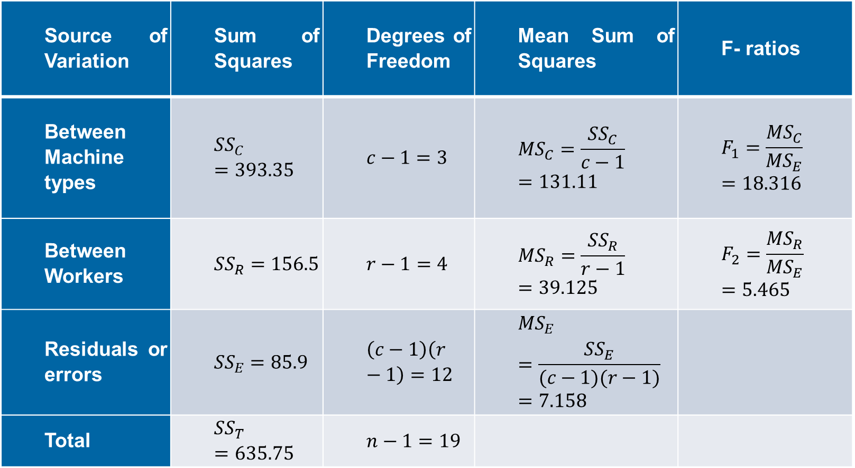
Source of Variation | Sum of Squares | Degrees of Freedom | Mean Sum of Squares | F- ratios
Between Machine types | $${SS}_{C}=393.35$$ | $$c−1=3$$ | $${MS}_{C}=\frac{{SS}_{C}}{c−1}=131.11$$ | $$F_{1}=\frac{{MS}_{C}}{{MS}_{E}}=18.316$$
Between Workers | $${SS}_{R}=156.5$$ | $$r−1=4$$ | $${MS}_{R}=\frac{{SS}_{R}}{r−1}=39.125$$ | $$F_{2}=\frac{{MS}_{R}}{{MS}_{E}}=5.465$$
Residuals or errors | $${SS}_{E}=85.9$$ | $$\left(c−1\right)\left(r−1\right)=12$$ | $${MS}_{E}=\frac{{SS}_{E}}{(c−1)(r−1)}=7.158$$
Total | $${SS}_{T}=635.75$$ | $$n−1=19$$

Slide 20

Table value $F_{0.05}\left(3, 12\right)=3.49$.
$F_{1}$> $F_{0.05}(3, 12)$, we conclude that the productivity is not same for the four different types of machines
Table value $F_{0.05}\left(4, 12\right)=3.26$.
$F_{2}$> $F_{0.05}(4, 12)$, hence the mean productivity differ with different workers.

Slide 21
T-test
Analyses the significant difference between means of two groups.
Different types
One Sample T-test
Independent Sample T-test
Paired Sample T-test

Slide 22

One Sample T-test
H0: $\overline{X}$= µ ; H1: $\overline{X}$ ≠ µ
Where $\overline{X}$ is sample mean, µ is actual mean.
The t value is calculated using
$t=\frac{\overline{X}−μ}{\frac{S}{√n}}$
Where s is the standard deviation and n is the sample size.
Degrees of freedom is n-1.

Slide 23

Independent Sample T-test
H0: $\overline{X}$1= $\overline{X}$2 ; H1: $\overline{X}$1 ≠ $\overline{X}$2
$\overline{X}$1 and $\overline{X}$2 are means of two independent samples.
The t value is
t = $\frac{\overline{X}\text{1}\text{−}\overline{X}\text{2}}{SE}$,
$$SE=\left\{\begin{aligned}\sqrt{\frac{S_{1}^{2}}{n_{1}}+\frac{S_{2}^{2}}{n_{2}}}, for different population \\ \sqrt{\frac{\left(n_{1}−1\right)S_{1}^{2}+\left(n_{2}−1\right)S_{2}^{2}}{n_{1}+n_{2}−1}\left(\frac{1}{n_{1}}+\frac{1}{n_{2}}\right)}, for same population\end{aligned}\right.$$
Degrees of freedom is n1+n2-2.

Slide 24

Paired Sample T-test
H0: $\overline{X}$d= 0; H1: $\overline{X}$d ≠ 0
Where $\overline{X}$d is the mean of difference between the pairs.
The t value is
$t=\frac{\overline{X}\text{d}}{\frac{s}{√n}}$
Degrees of freedom is n-1.

Slide 25
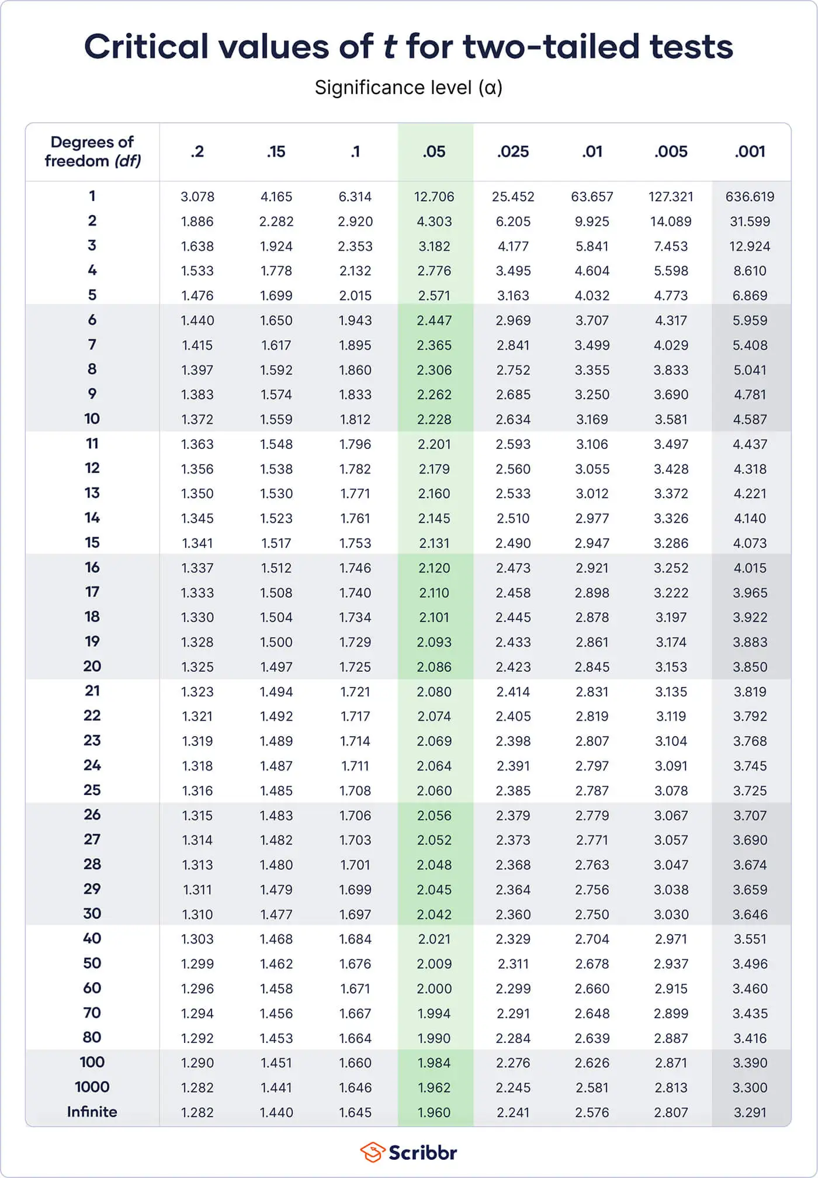
Critical t value
If ɑ is the significance level and d be the degrees of freedom then tc is value corresponding to
a (coloumn) and d (row).
Example:
a=0.05 d=7 then tc is 2.365.

Slide 26

Steps
Calculate Value of t
Find the critical tc value from the table.
If $t>t$c,
Reject H0

Slide 27
Example
A public health official claims that the mean home water use is 350 gallons a day. To verify this claim, a study of 20 randomly selected homes was instigated with the result that the average daily water uses of these 20 homes were as follows:
340 344 362 375
356 386 354 364
332 402 340 355
362 322 372 324
318 360 338 370
Do the data contradict the official’s claim?

Slide 28

Solution
H0: $\overline{X}=350;$
H1:$\overline{X}≠350;$
Degrees of freedom is 20-1=19
tc = 2.093
$S^{2}$=$\frac{\sum_{i=1}^{20}{(Xi−μ)^2}}{n}$= 21.8478
t= (353.8 -350)$\frac{√20}{21.8478}$=0.7778
t< tc
Accept H0

Slide 29
Example
An industrial safety program was recently instituted in the computer chip industry. The average weekly loss (averaged over 1 month) in man-hours due to accidents in 10 similar plants both before and after the program are as follows:
Determine, at the 5 percent level of significance, whether the safety program has been proven to be effective.

Slide 30
Table
Plant | Before | After | After- Before
1 | 30.5 | 23 | -7.5
2 | 18.5 | 21 | 2.5
3 | 24.5 | 22 | -2.5
4 | 32 | 28.5 | -3.5
5 | 16 | 14.5 | -1.5
6 | 15 | 15.5 | 0.5
7 | 23.5 | 24.5 | 1
8 | 25.5 | 21 | -4.5
9 | 28 | 23.5 | -4.5
10 | 18 | 16.5 | -1.5

Slide 31

Solution
H0: $\overline{X}$d= 0; H1: $\overline{X}$d ≠ 0;
$\overline{X}$d = -2.35
S=3.007
t = 2.471
Degrees of freedom= 10-1=9
tc = 2.2625
t > tc we reject H0

Slide 32
Example
For a random sample of 10 persons, fed on a diet A, the increase in weights measured in pounds for a certain period were: 10, 6, 16, 17, 13, 12, 8, 14, 15, 9.
For another random sample of 12 persons, fed on a diet B, the increase in the same period were: 7, 13, 22, 15, 12, 14, 18, 8, 21, 23, 10, 17.
Test whether diets A and B differ significantly as regards their effect on an increase in weight

Slide 33
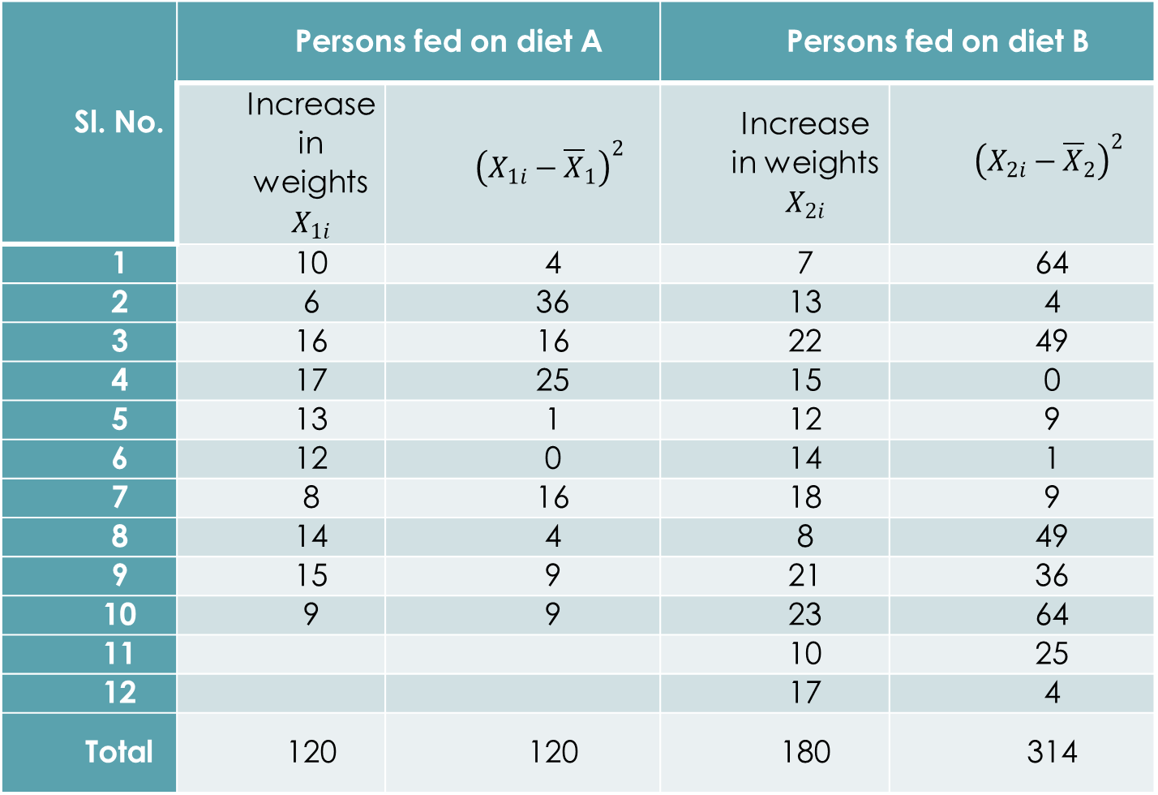

Solution
H0: $\overline{X}$1= $\overline{X}$2 ; H1: $\overline{X}$1 ≠ $\overline{X}$2
n1=10 n2=12
Degrees of freedom is 10+12-2=20
tc= 2.086
S=$\sqrt{\frac{\left(n_{1}−1\right)S_{1}^{2}+\left(n_{2}−1\right)S_{2}^{2}}{n_{1}+n_{2}−2}\left(\frac{1}{n_{1}}+\frac{1}{n_{2}}\right)}=4.6583$
$\overline{X}$1=12, $\overline{X}$2 =15
$t=\frac{{\overline{X}}_{1}−{\overline{X}}_{2}}{SE}=1.51$
t < tc Accept the H0

Slide 34
References
Ross, S. (2009). Probability and statistics for engineers and scientists. Elsevier, New Delhi, 16, 32-33.

Slide 35
Thank You

